Slide 1


Check Your Standard: PREFORMA and MediaConch
Erwin Verbruggen
Netherlands Institute for Sound and Vision
JTS 2016 – NMS Singapore

Slide 2
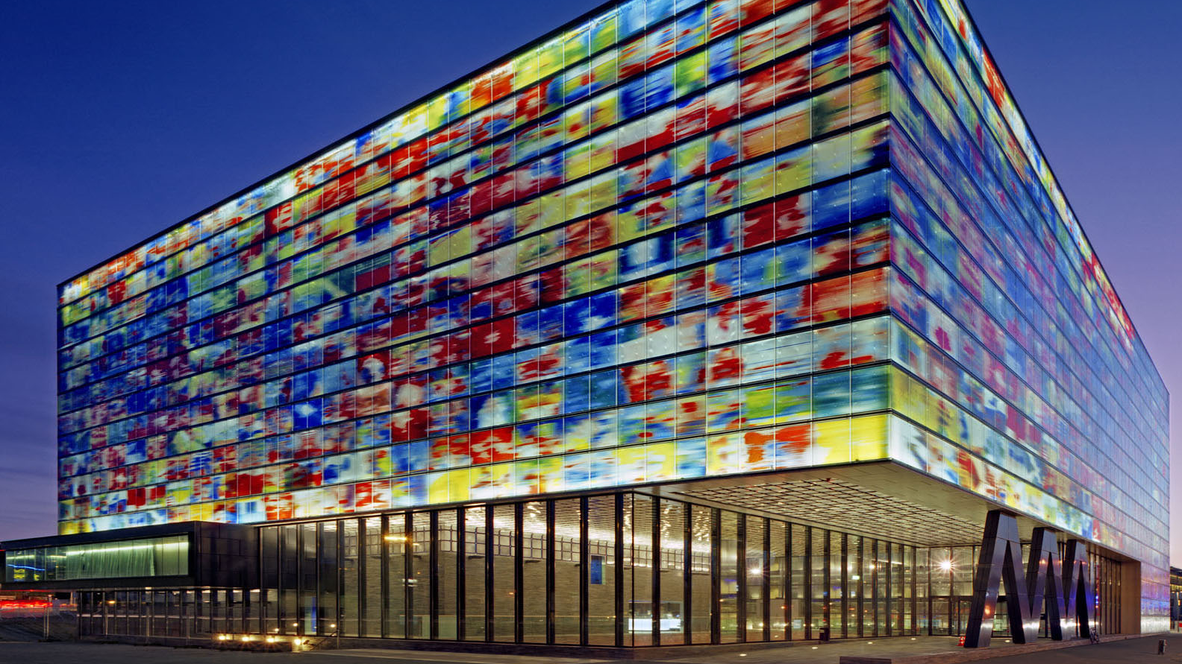
Notes:
Hello, my name is Erwin Verbruggen and I work at the Netherlands Institute for Sound and Vision.
Sound and Vision is the business archive of the Dutch broadcasting corporations and one of the largest audiovisual archives in Europe.
From 2007 to 2014, we were engaged in the large-scale digitisation programme Images for the Future.
We make available tens of thousands of hours of archive footage online for various end-user services, including dedicated services for the creative industries, education and research.
The institute operates as a visitor attraction aimed at the general public and is visited by over 250,000 people annually.

Slide 3

Labs.beeldengeluid.nl
Prestocentre.eu
Openimages.eu
bit.ly/flossinventory
Notes:
The Research and Development department at Sound and Vision consists of 17 people out of a total of 115 full time personnel at the institute.
We represent various disciplines, such as Media Studies, Computer Science, Web Science and Information Law.
We are involved in a wide range of research projects and operate a labs environment that allows researchers to deploy large-scale experiments.
They can use state of the art hardware and a range of software tools and we have a core team of back-end and front-end developers available to collaborate with researchers.
The policy of Sound and Vision is to publish software under open licences on publicly available repositories.
Other tool inventories we maintain:
PrestoCentre
Open Images
FLOSS Inventory

Slide 4
Conformance Checker in Preservation
File has been produced according to the specifications of a standard file format
File matches the acceptance criteria for long-term preservation by a memory institution
Reports which properties deviate from the standard specification and acceptance criteria
In human and machine readable format
Performs automated fixes for simple deviations in the metadata of the preservation file.
Notes:
Gaining Control over File Maintenance and Validation in Audiovisual Collections - What is a robust file validation process for digital assets in a AV archive?
Allow memory institutions to check the conformance of documents with respect to their reference standards (content + structure) in order to ensure their appropriateness for long-term preservation
The only current means we have to safeguard files from future inutility is keeping track of viable formats - a task taken up bu various format registries. [1] One of the most important technical challenges institutions and long-haul organisations face is the tactic of normalising the files they take responsibility over. When an organisation decides to limit the amount of file types it takes responsibility for, it makes managing these files a less haphazard task. Homogeneous collections allow for bulk monitoring and bulk solutions.
A conformance checker:
– verifies whether a file has been produced according to the specifications of a standard file format, and hence,
– verifies whether a file matches the acceptance criteria for long-term preser- vation by the memory institution,
– reports in human and machine readable format which properties deviate from the standard specification and acceptance criteria, and
– performs automated fixes for simple deviations in the metadata of the preser- vation file.
We need to know the files we create, FFv1 or V210 or IMF or MXF or whatever, are healthy. Similarly, for born digital assets, we need to validate their structure, too. If a file is mal-formed upon arrival (like the annoying padding byte error in mono WAV files), we want to know that day 1, not 50 or 500 years from now. Whether our policies say we should correct that error (and change the original), or note the flaw in the metadata (where?, As PREMIS event?), we need tools for that purpose.

Slide 5
In OAIS Terms
Notes:
The conformance checker software developed by PREFORMA is intended for use within the Open Archival Information System (OAIS) Reference Frame- work [19] and development is guided by the user requirements provided by the memory institutions that are part of the PREFORMA consortium.

Slide 6
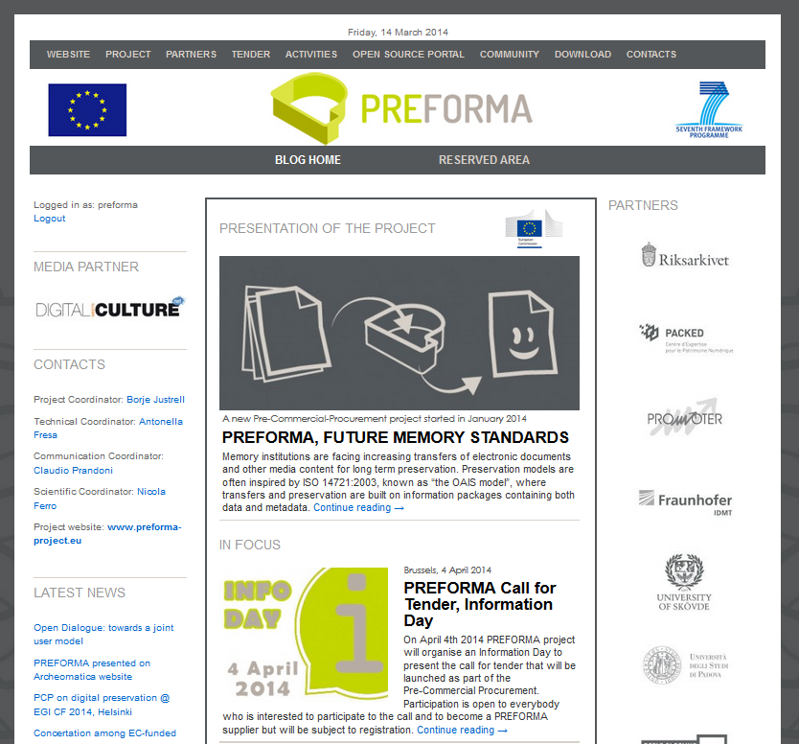
PREFORMA
Empowers memory institutions to gain full control over the technical properties of digital content intended for long-term preservation
Slide with thanks to Claudio Prandoni
Notes:
Together with partners from Italy, Sweden, Belgium, Germany, Greece and Spain we participate in the Pre-Commercial Procurement project PREFORMA.
It is co-funded by the European Commission, under its FP7-ICT Programme to create a win-win situation in which memory institutions' professional knowledge is matched with suppliers' skills in the development and promotion of new products.
The main objective of the pre-commercial-procurement is the development and deployment of an open source, software licensed, reference implementation for file format standards aimed at any memory institution wishing to check conformance with a specific standard.

Slide 7
Reference Standard
For PREFORMA:
Format can capture content in an uncompressed or mathematically lossless encoding, and retain as many original properties as possible (ie. bit-depth, resolution, …)
Format is Free/Libre (cf EIFv1)
Format is well documented
Format has been adopted
Notes:
The media types addressed by PREFORMA are:
electronic documents for establishing a reference implementation for PDF/A [20–22];
images for establishing a reference implementation for uncompressed TIFF [17,18]; and,
audio-video for establishing a reference implementation for an audiovisual preservation file, using FFV1 for encoding video or moving images, uncompressed LPCM [15] for encoding sound and MKV for wrapping audio- and video-streams in one file.
For long-term preservation of digital video sustainable container formats as well as audio/video codecs are necessary. There is no consensus to date among the archival community as to which file format or codecs should be used for preservation purposes for digital video.^{[6]} The previously proclaimed encodings were Motion JPEG 2000 (lossless)^{[7]} and uncompressed video.^{[8]}
FFV1 has turned out to be a viable addition to that choice and was therefore recently added as a suitable option for preservation encoding.^{[3][9]} With compression ratios comparable to JPEG 2000 lossless and its lower computing requirements, it is already being used by professional archives as their long-term storage codec. Especially archives where the collections do not feature extensive broadcast materials but rather consist of, oral history-, ethnographic-recordings and the likes, "favored the lossless FFV1 encoding" in communications with the "Federal Agencies Digitization Guidelines Initiative" (FADGI) team.^{[10][11]}
It is also listed as a format option for long-term preservation of moving images on sites of the U.S. Library of Congress',^{[9][16]}State Records NSW^{[6]} and others. The Society of American Archivists has published a paper in August 2014, suggesting only FFV1 as preservation codec for video.^{[17]}
The Digital Preservation project at the U.S. Library of Congress identified AVI and Matroska as common container formats for FFV1.^{[18][19]}
List of institutions known to use FFV1
United Kingdom The National Archives (United Kingdom)
Canada City of Vancouver Archives^{[20][21][22]}
Museum Victoria (Australia)
United States National Library of Medicine (Washington DC)
University of Notre Dame Archives
University of Texas Libraries (FFV1 in MKV for DVD preservation^{[23]})
Indiana University^{[13]}
Austria Austrian Museum of Modern Art (MuMoK): For their collection of art videos.
Danube University Krems (Lower Austria/Niederösterreich)
Filmarchiv Austria (Austrian Film Archive)]]: For their telecined DigiBeta copies of some films.
Landesmuseum Niederösterreich (de) (State Museum of Lower Austria)^{[24]}
Österreichische Mediathek (Austria's national audio/video archive)^{[25][26]}

Slide 8
Open standard? | AUDIOVISUAL |  |  | TEXT | IMAGE
 | broadcast | film | Consumer
PREFORMA stakeholders | MPEG-IMX (MXF/MPEG2) XDCAM HD422 (MXF/MPEG4) | DPX DCP (MXF/JPEG2000) | MOV/MPEG2 AVI/MPEG2 MPEG/MPEG2 MPEG/MPEG4-AVC | PDF 1.4 PDF/A1 | TIFF 6.0 JPEG JPEG2000 RAW
Industry standards | AS|07 (MXF/MPEG2) (MXF/JPEG2000) FIMS (MXF/MPEG2) | DCDM (TIFF 6.0) DCP (MXF/JPEG2000) IMF (MXF/MPEG4) | MPEG-AF | PDF | JPEG2000 TIFF
Open standards | MKV/FFV1 OGG/Dirac | PNG | WebM/VP8 OGG/Theora | PDF/A1 PDF/A3 PDF/A3 | PNG
PREFORMA | MKV (?) | OGG | JPEG2000 (?) | FFV1 | Dirac | LPCM (?) |  |  | PDF/A | TIFF 6.0 (?)
Slide with thanks to Bert Lemmens
Notes:
Deciding on an open source reference format for video was more complicated. For the AV RECORDS the standards specifications to be checked werea combination of:
​Wrapper: MKV (http://www.matroska.org/technical/index.html)
​Wrapper: Ogg (https://xiph.org/ogg/doc/)
​Video encoding: Lossless JPEG2000 (ISO/IEC 15444-1:2004)
​Video encoding: Lossless FFV1 (http://www.ffmpeg.org/~michael/ffv1.html)
​Video encoding: Lossless Dirac v2.2.3 (http://diracvideo.org/download/specification/dirac-spec-latest.pdf)
​Audio encoding: Linear PCM (IEC 60958-1 ed3.1 Consol. with am1: 2014)

Slide 9

“FFv1/MKV are gaining traction in a corner of the community - whether for size, hipness, anti-establishment, simpler-than-MXF, "free", or open or whatever.”
George Blood, AMIA List, 2015-12-03
See Session 7: Review and comparison of FFV1 versus other lossless video codecs - Peter Bubestinger

Slide 10
Challenge Brief
Develop an open source conformance checker that:
checks if a file complies with standard specifications
checks if a file complies with the acceptance criteria of the memory institution
reports back to human and software agents
performs simple fixes
Establish an ecosystem around an open source reference implementation that:
generates useful feedback for those who control software
advances improvement of the standard specification
advances development of new business cases for managing preservation files
Slide with thanks to Claudio Prandoni
Notes:
The expected outcomes include:
​The development of an open source conformance checker that checks if a file complies with standard specifications, checks if a file complies with the acceptance criteria of the memory institution, reports back to human and software agents and perform simple fixes.
​Secondly, the establishment of an ecosystem around an open source reference implementation that generates useful feedback for those who control software, advances improvement of the standard specification and advances development of new business cases for managing preservation files.
The PREservation FORMAts for culture information/e-archives (PREFORMA)1 project is a Pre-Commercial Procurement (PCP) project focused on conformity checking of ingested files for the long-term preservation
The main objective of the project is the development and deployment of an open source software licensed reference implementation for file format standards aimed at any memory institution (or other organisation with a preservation task) wishing to check conformance with a specific standard.
This reference implementation, called the conformance checker, will consist of a set of modular tools which will be val- idated against specific implementations of specifications of standards relevant to the PREFORMA project and used by the European memory institutions for preserving their different kind of data objects.
The PREFORMA set-up allows the sharing of resources of a variety of collection owners to gain access to industry. With support from the European Union, this financial support gives the group the resources to bring in incentives to invite industry players to work on open formats and open the market. The way this is achieved is by means of the model of a pre-commercial procurement, which allows funding initial R&D. This tool allows for a close collaboration between, in this case, the heritage sector and selected specialist instances.
The pre-commercial procurement approach in PREFROMA funds the standardisation and initial development of open source components. Through this approach, innovation among service providers is fostered. The group has organised three providers around new and established standards - the well-known PDF/A standard for PDFs, the newly formed TI/A specification for TIFF and a proposed standard for preservation-level audiovisual files using a Matroska-wrapped FFv1 video codec with linear pulse code modulation.
The procurement approach ensures that the business model of the service provide is centered around providing a sustainable solution, rather than solving interoperability problems.

Slide 11


The PREFORMA Outcomes
VeraPDF Consortium:
Open Preservation Foundation
PDF Association
Digital Preservation Coalition
PDF/A Validation
TI/A Standard Initiative:
Digital Humanities Lab / University of Basel
Agents Research Lab / University of Girona
Easy Innova
DPF Manager
Notes:
The first design phase lasted four months
Six suppliers were selected (two for each media type) and the suppliers of the three best designs were requested to proceed to the current prototyping phase.
The question of an open source reference format was rather straight-forward for documents and images. The VeraPDF consortium works with industry partners on the PDF/A standard. Supplier Easy Innova developed the TIFF/A standard initiative arround which it develops its conformance tools.

Slide 12
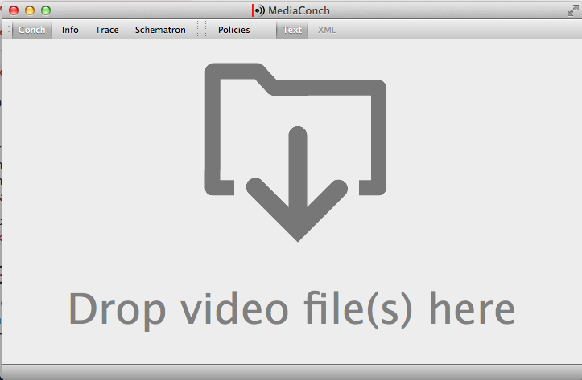
MediaConCh
Notes:
The MediaArea team has worked on several software tools used in preservation data conformance, including MediaInfo, a tool to extract metadata from audio and video files, and Bay Area Video Coalition's QCTools project, a tool that performs quality control checks and analysis on digitised analog video.
MediaArea is one of three teams that have moved forward from Phase 1 (design) into Phase 2 (software prototyping). This second phase will last 22 months. The research conducted during Phase 1 is available on PREFORMA’s Open Source Portal. In collaboration with Open Preservation Foundation and Easy Innova, MediaArea will develop a software framework for checking media files.
In Phase 1, MediaArea was tasked with researching community standards and developing file conformance checks for FFV1 (a lossless video codec), Matroska Multimedia Container, and Linear Pulse-Code Modulated Audio (LPCM) to support efforts of long-term preservation in memory institutions. In Phase 2, MediaArea will be developing MediaConch, an extensible, open source software project consisting of an implementation checker, policy checker, reporter, and fixer that targets preservation-level audiovisual files. It will provide detailed and batch-level file conformance checking via an adaptable and flexible application program interface accessible by the command line, a graphical user interface, or a web-based shell. Our prototype phase objectives and workplan include collaborations with partners from Matroska, FFmpeg, and libav. MediaArea will also work closely with Artefactual Systems in order to implement selected results into their flagship repository system, Archivematica.

Slide 13

Notes:
MediaArea’s design plan to create a toolset consisting of an implementation checker, policy checker, reporter, and fixer of a select list for formats. Conch is currently being developed by the MediaArea team, notable for the creation of open source media checker software, MediaInfo.
MediaConch is an extensible, open source software project based on the well-known MediaInfo toolbase that focuses on Matroska, Linear Pulse Code Modulation (LPCM) and FF Video Codec 1 (FFV1)) for use in memory institutions,
It provides detailed and batch-level conformance checking in four formats
- Command line
- GUI
- Server (Rest API)
Web interface
## MC & OS
- GPLv3+ and MPLv2+
- Relies on MediaInfo (metadata extraction)
- Uses Qt, sqlite, libevent, libxml2, libxslt, libexslt...
Formats
- Prioritizes
- Matroska
- FFv1
- PCM
- Also
- Can accept any format supported by MI
- Mainly as a policy checker
- Implementation checker for other formats can be developed in the future
## Versatile
- Binaries provided for
- Windows
- Mac
- Linux
- Can be ported on other distros
- Input can be from
- Files
- FTP/FTPS/SFTP
- HTTP/HTTPS
- Amazon S3

Slide 14
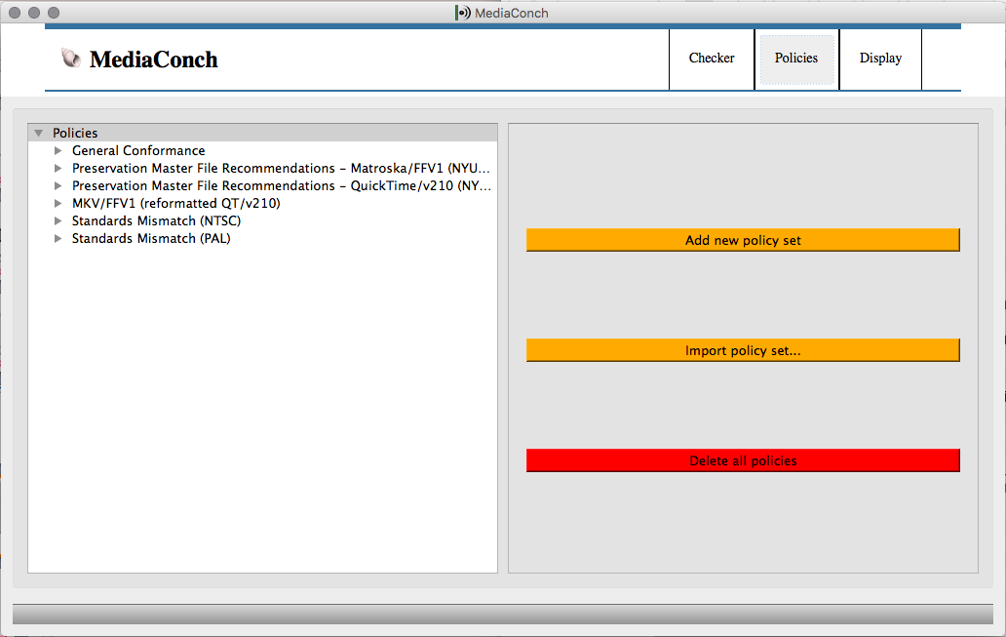
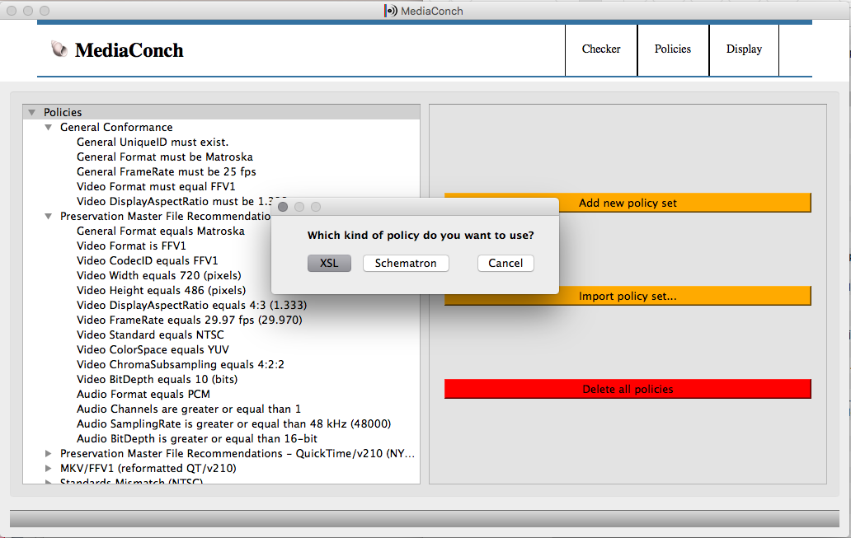
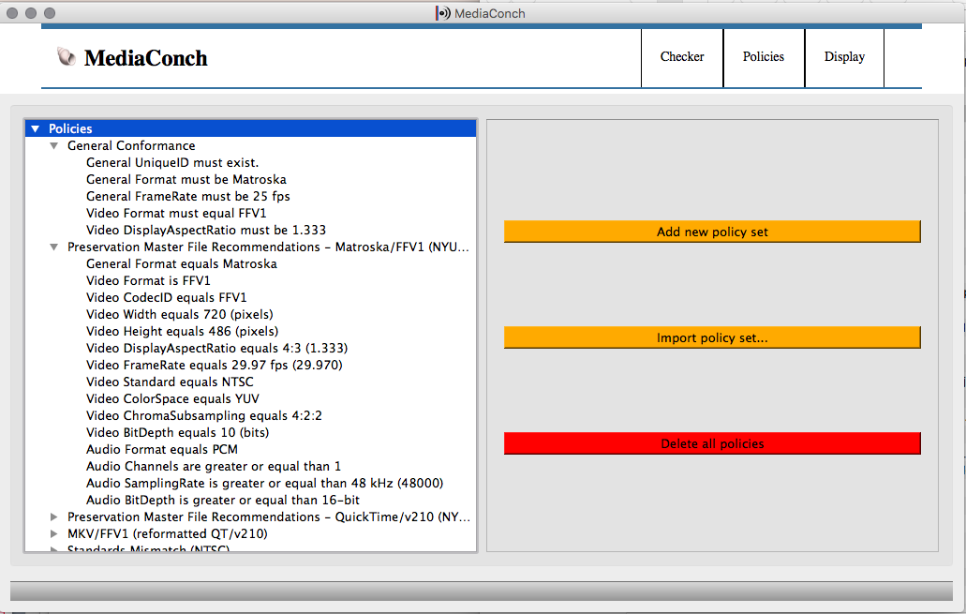
Notes:
Current MediaConch software verifies that files conform to the standards set forth by Matroska, FFV1, and LPCM.
Results are exported as XML.
Two options of XML are given for export: standard, descriptive XML or extensive, trace XML.
Both XML standards have been manufactured to be easily read by both humans and computers.
In addition to checking files for conformance at a basic level, MediaConch has developed a policy checker that allows archives, museums, and other memory institutions
to create their own policies to which files should comply.
Policy checker schemas can check to verify that files fall into parameters specific to the institution or collection.
The policy checker can limit files to a range, require that files have video and audio streams, or conform to a broadcast standard like PAL.

Slide 15
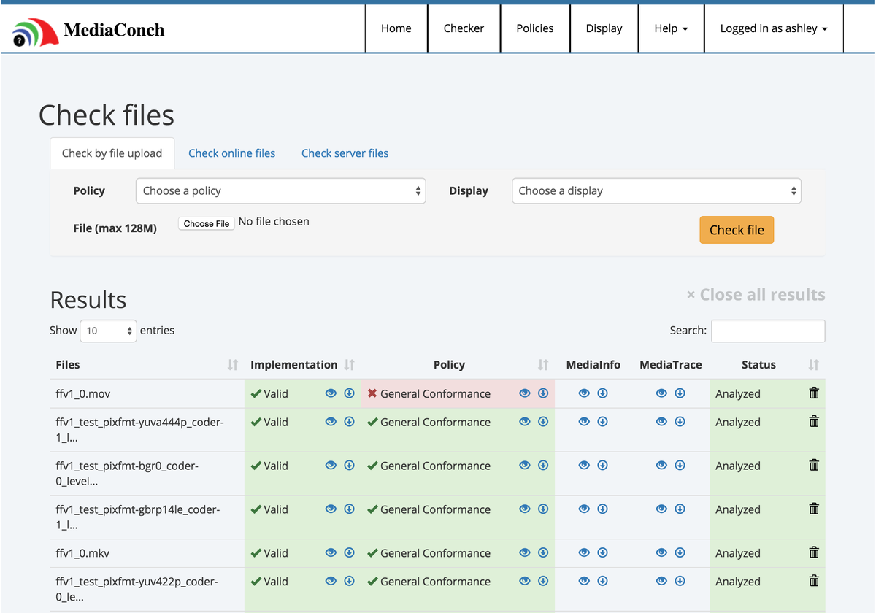
Notes:
a new reporting feature for documenting the structure and contents of digital files with a particular concentration on audiovisual data. A complementary tool of MediaInfo that summarizes a file’s significant characteristics, MediaTrace offers comprehensive documentation of file information in a powerful XML format for precision identification and conformance checking.
MediaTrace is a technical report that expresses the binary architecture of a file as interpreted by MediaArea tools such as MediaInfo, starting in version 0.7.76, and MediaConch, starting in version 2015-07.
Although MediaTrace reports may document any file format, the tools that generate it, MediaInfo and MediaConch, are optimized to report on audiovisual formats.
Many audiovisual formats are based on chunk-based storage where a block of data will either contain a data payload or other blocks. In QuickTime parlance these blocks are called atoms, in AVI “chunks”, and in Matroska, “elements”. MediaTrace will attempt to parse apart each block into subdivisions and report on their contents.
Whether the source format specification calls it element, atom, chunk, or another term, MediaTrace will call it a <block>. In MediaTrace the contents of the block are called <data>.
MediaTrace provides a relatively simple and generic structure to document the complex and diverse internal structure of audiovisual files. MediaInfo’s parsers determine how to label and dissect such data and therefore the MediaTrace values such as name or the granularity of the parsing many change over time. MediaArea makes an effort to keep the names used in MediaTrace consistent with the specifications that define the formats being parsed.
MediaTrace can also be used to identify embedded fixity features in files, such as cyclic redundancy checks (CRCs) found in the FFV1 video codec. Here the information includes the size of the associated frame region or “slice”, the computed CRC, and an error status of “0” (no error).
An XML Schema for MediaTrace is available at https://mediaarea.net/mediatrace/mediatrace.xsd. A data dictionary is also provided at DataDictionary.md. The development history for both the XML Schema and data dictionary are available at Github.

Slide 16




CELLAR
Codec Encoding for LossLess Archiving and Realtime transmission
Project Advisors
Notes:
The goal of the PREFORMA project is to address the challenge of implementing good quality standardised file formats for preserving data content in the long term.
Our objective in regards to standardization FFV1 and Matroska is to improve the sustainability factors for both formats including disclosure, credibility, and transparency while also creating a mechanism to clarify, authoritatively, the intent of the specifications.
The MediaArea team is dedicated to the further development of the standardization of the Matroska and FFV1 formats to ensure their longevity as a recommended digital preservation file format.
After presenting on FFV1 and Matroska at IETF 94 this past summer, theyhave incorporated feedback and input from IETF members to draft a new charter for a proposed working group that includes FFV1, Matroska, and FLAC under the Proposed Name: CELLAR: Codec Encoding for LossLess Archiving and Realtime transmission
Codec Encoding for LossLess Archiving and Realtime transmission
In order to develop the FFv1/Matroska standard, the supplier group erected a working group within the infrastructure of the Internet Engineering Task Force, titled CELLAR, or Codec Encoding for LossLess Archiving and Realtime transmission. As all the Task Force's working groups, it works in an open sense - by means of mailing lists and open gatherings.
As of 2015, standardization of FFV1 through the Internet Engineering Task Force (IETF) is work in progress as part of the European PREFORMA Project,^{[12]} as well as implementation of a conformance checker for FFV1/PCM in a Matroska (MKV) container.^{[13]} Details of FFV1's standardization plan^{[14]} have been prepared by MediaArea as part of their conformance checking tool "Media CONCH".^{[15]}

Slide 17
A look forward
MediaConch development:
Asynchronous mode
UI Improvements
Statistics
Standardization
More conformance tests
PREFORMA Runs until 2017 – user base in place
Including at Sound and Vision?
Notes:
The MXF specification is broad enough for organisations to adopt a specific profile - either a specification or shim. Within the Dutch public broadcasting environment efforts to agree on an established profile for an exchange format started under the *Digitale Voorziening* working group in 2003. The effort was initiated buy the then called Nederlands Omroepproduktie Bedrijf (NOB) [1] in collaboration with the public broadcasting organisations and the Netherlands Institute for Sound and Vision. MXF was taken into account because the working group considered it an open standard. The approval of the standard happened in 2004. The working group agreed on the MPEG-2 format using D10 encoding [2] in 30 (D10-30) and 50 Mbps (D10-50). In order to gather feedback from users, a user group was established that meets frequently to discuss necessary changes to the format. Similar developments have taken place in other environments sharing workflows. Digital Cinema Initiatives, who developed the DCP flavour of MXF, was a joint venture of six major motion picture studios. The specification has been adopted by cinema infrastructures on a global scale. In the UK, the Digital Production Partnership published its format agreement between public and commercial broadcasters as well as various independent post-production houses in 2012. The partnership took the AMWA AS-11 as overall specification, with broadcaster-specific adaptations for each broadcaster, with an additional minimum set of requirements for Programme Editorial and Technical Metadata.

Slide 18
What You Can Do
CELLAR participation
Implement CRC-32 into Matroska and FFV1
QC for all interfaces
Bug tracking, reporting
Documentation
Your weird video errors
Your codebase
Notes:
## Want to help?

Slide 19
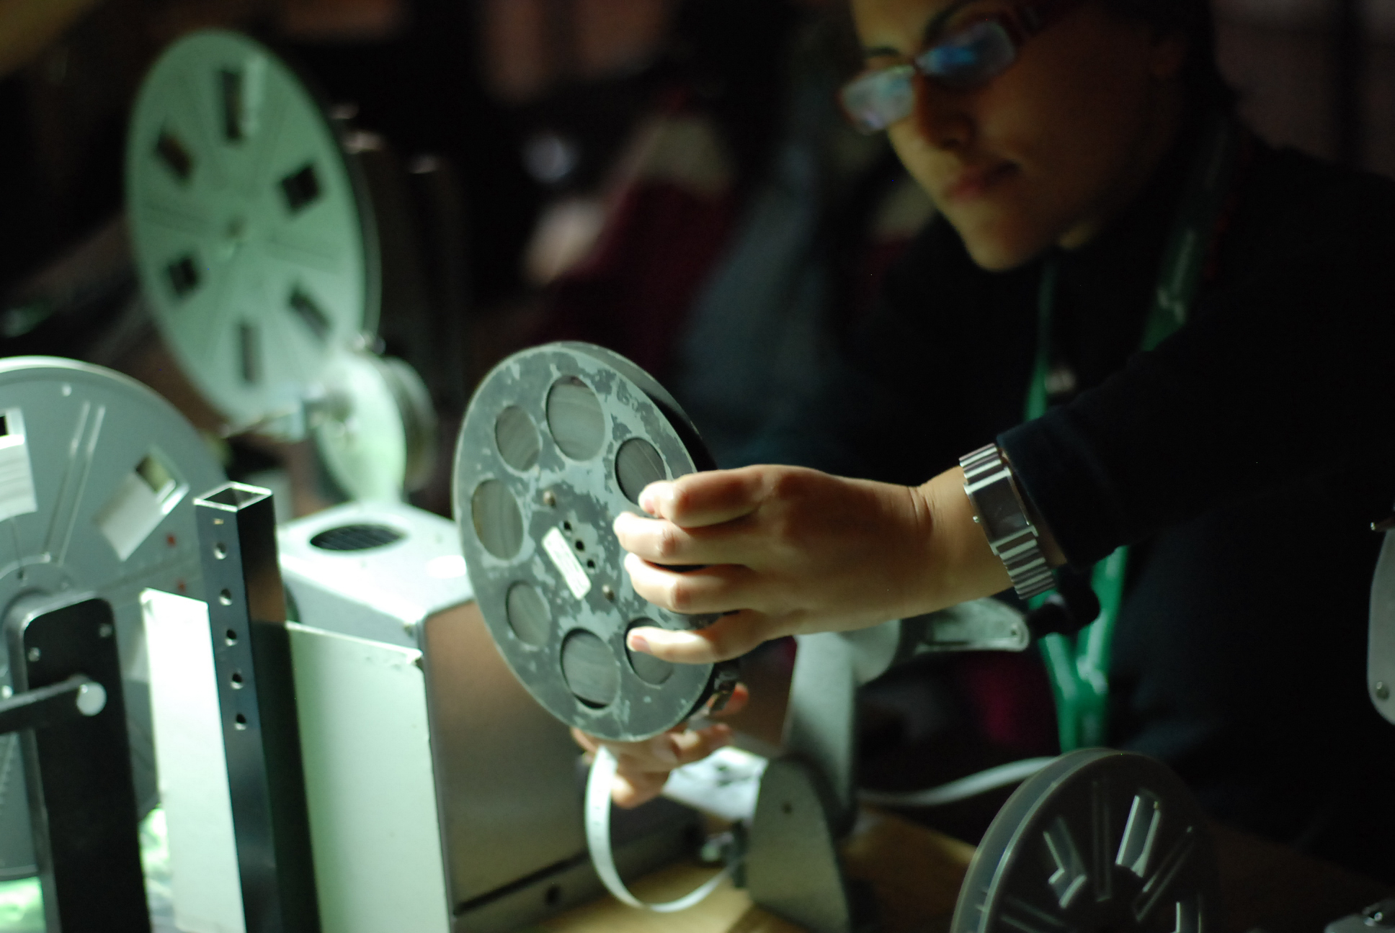

Workshop
Notes:
The project will be presented at a workshop in Stockholm, but before that time you are welcome to:
Test the software via regular releases on GitHub
Join the standardization effort in the IETF working groups
Commit test files and procedures to assist in further development of the project.

Slide 20
Thank You!
everbruggen@beeldengeluid.nl @erwinverb | @benglabs
mediaarea.net/MediaConch
https://github.com/MediaArea/MediaConch
@MediaConch
preforma-project.eu

